Slide 1
IT Budget Benchmark
Sample IT Budget For Midsize SampleCo 5 May 2022

Slide 2
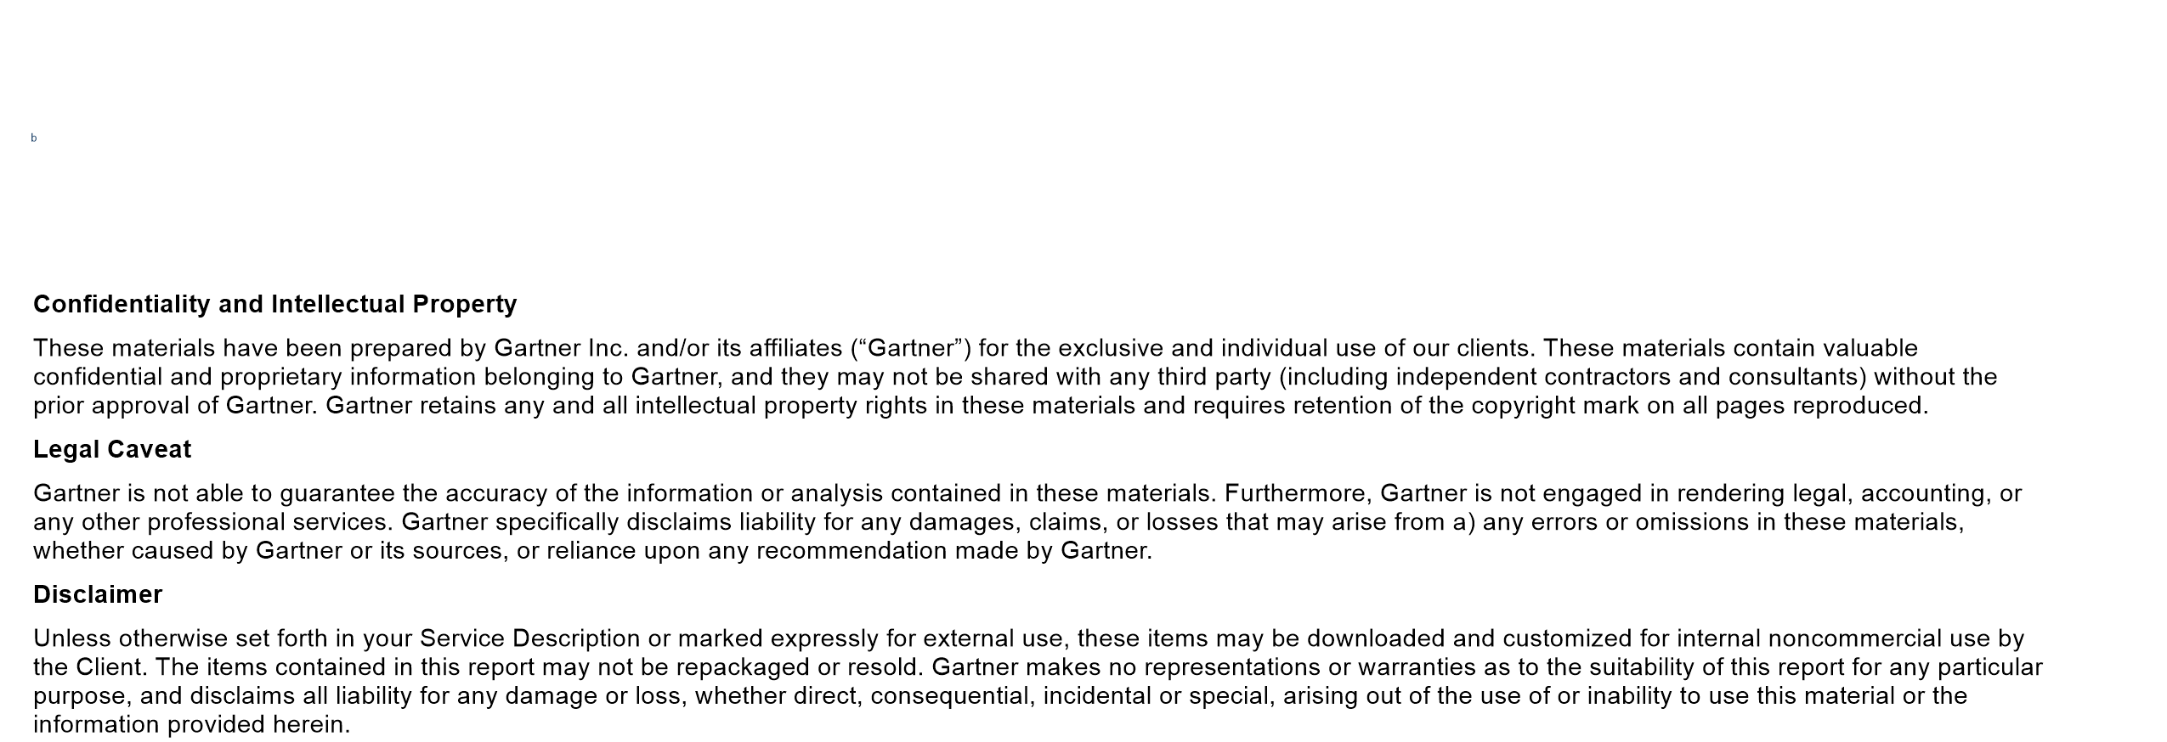
Disclaimer

Slide 3
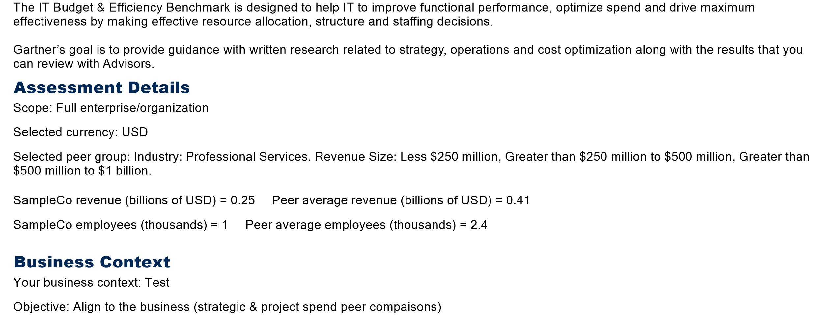
Introduction

Slide 4
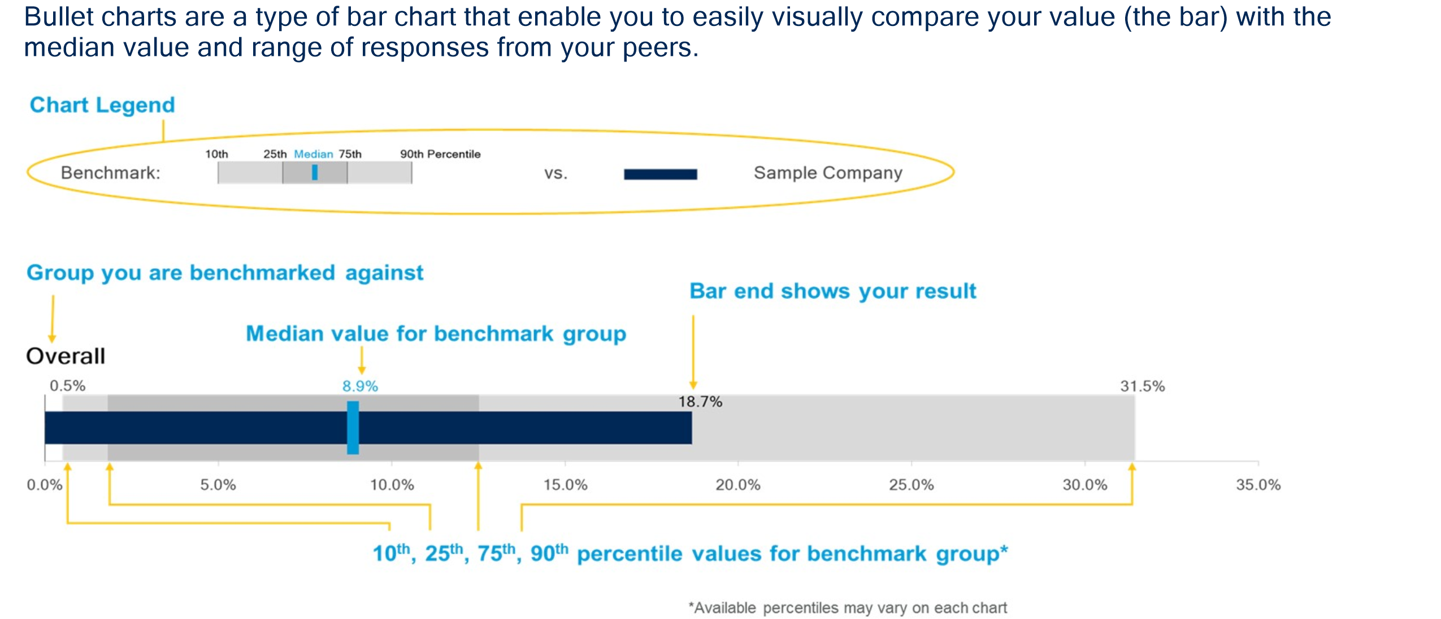
Bullet Chart Interpretation

Slide 5
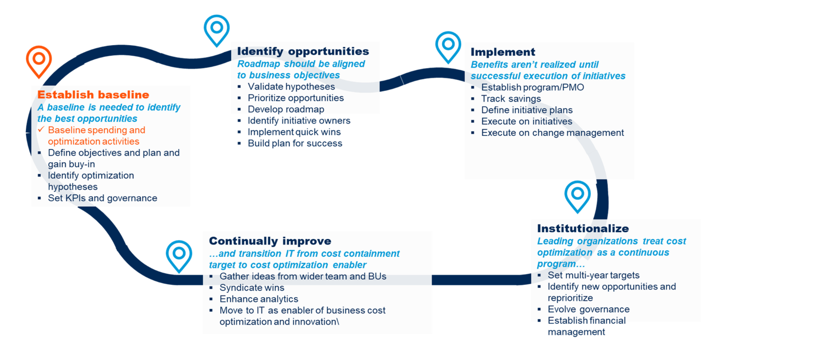
IT Budget Supports the Strategic Cost Optimization Life Cycle to Establish a Baseline and Measure Continuous Improvement​

Slide 6


Slide 7
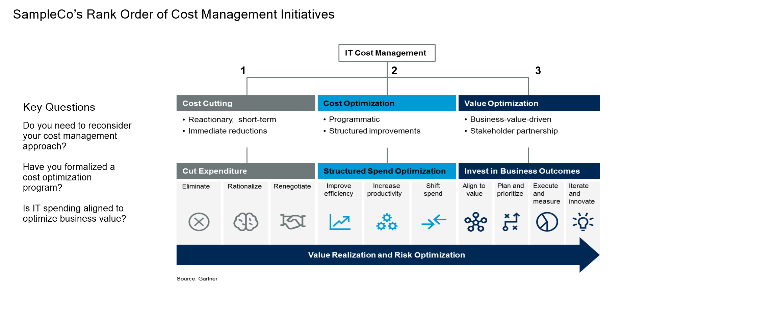
Top-Performing CIOs Deliver Value by Managing IT Costs Strategically and Programmatically to Drive Business Outcomes

Slide 8
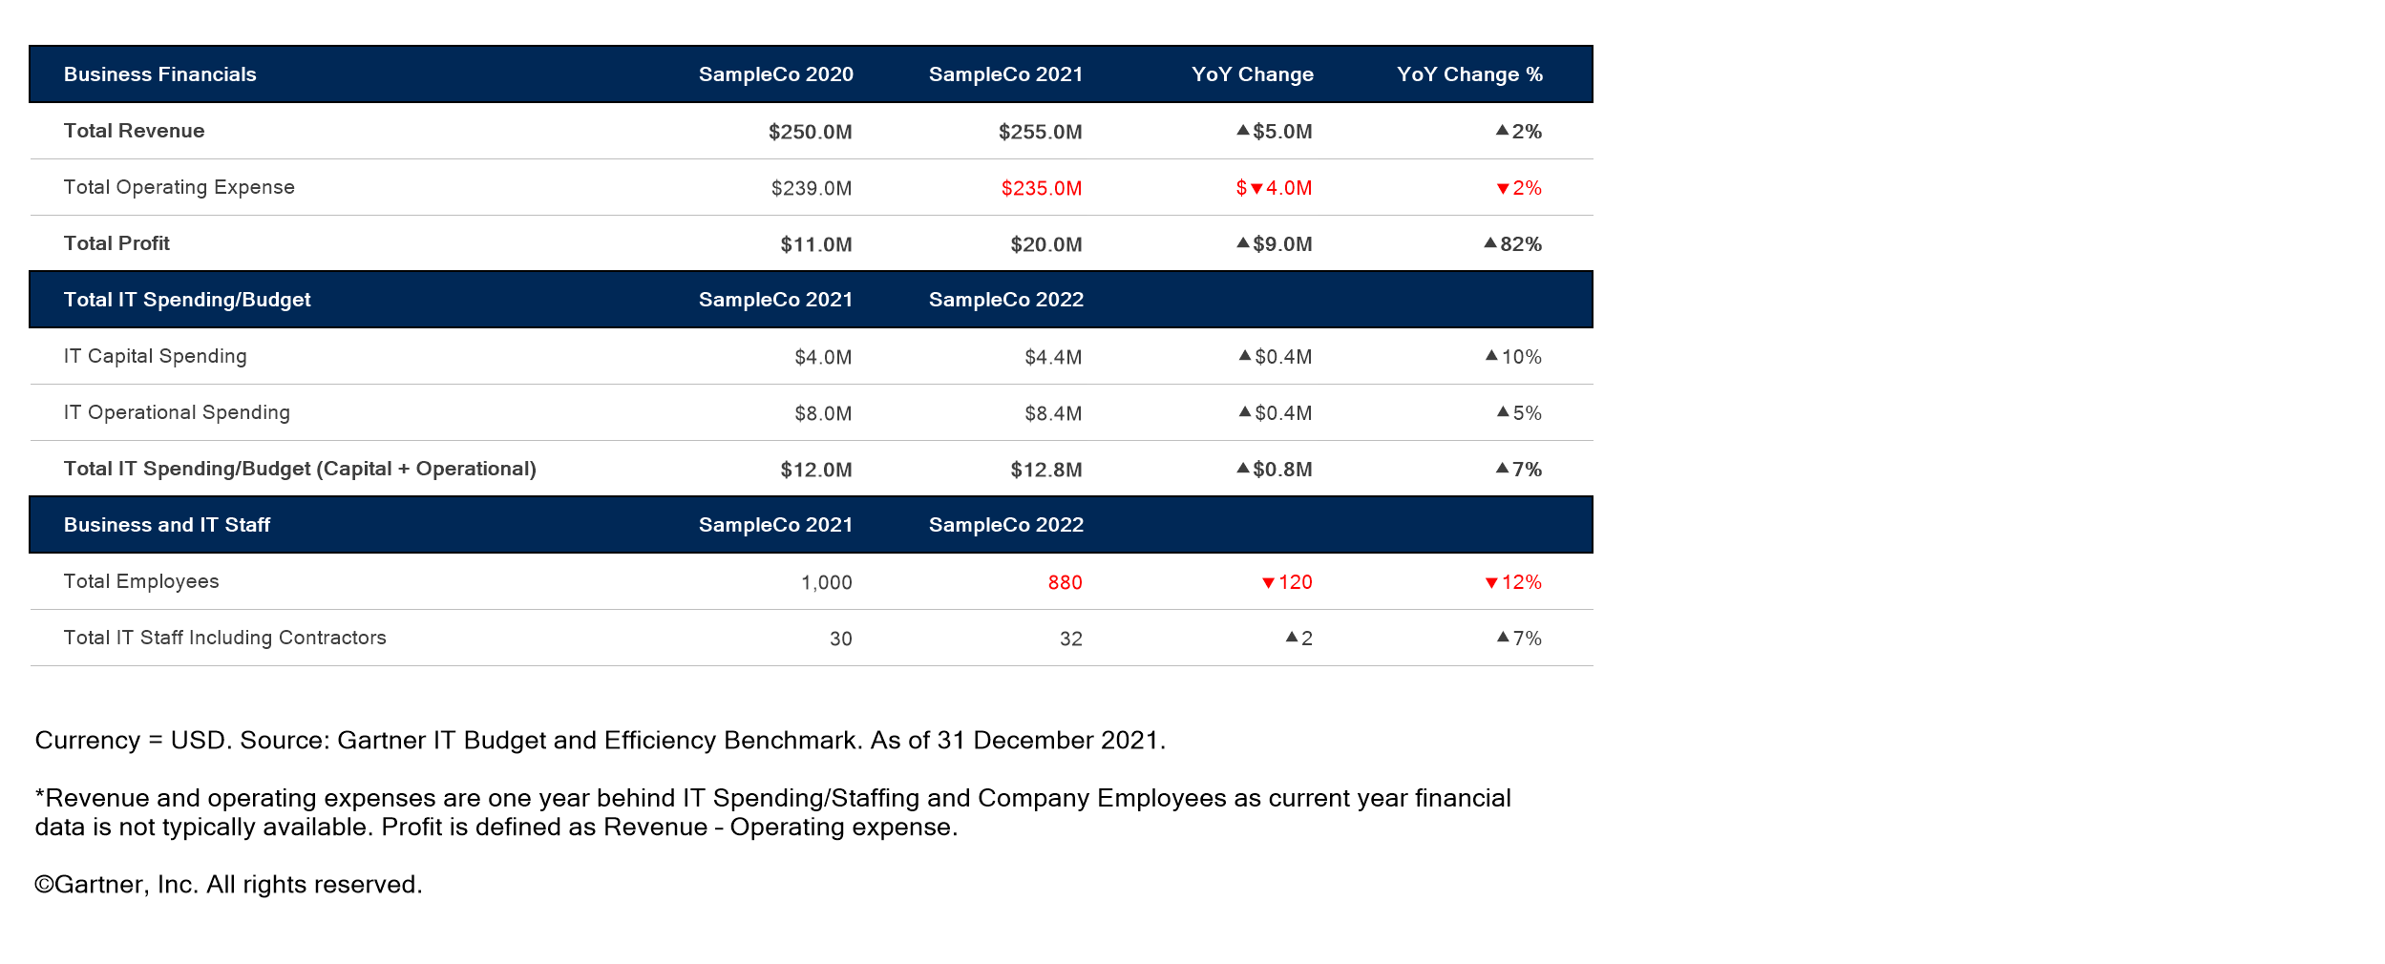
SampleCo Profile

Slide 9
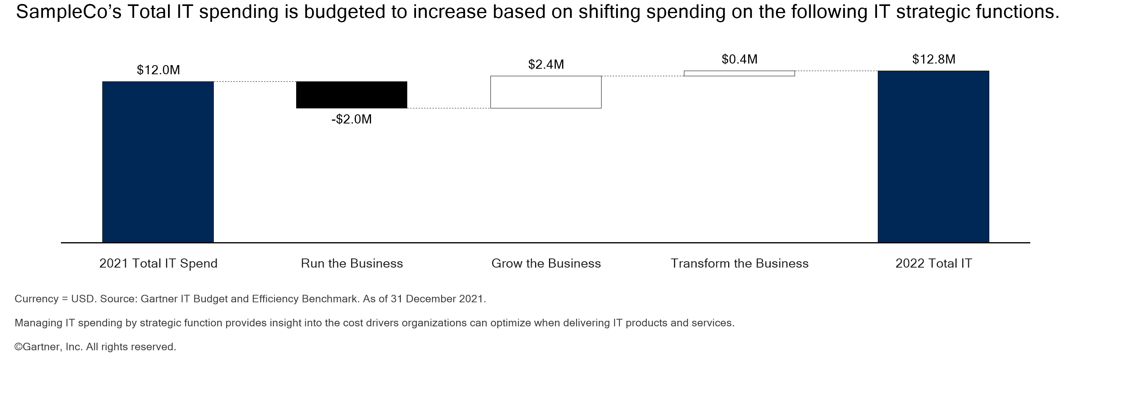
IT Spend Change by Strategic Category

Slide 10
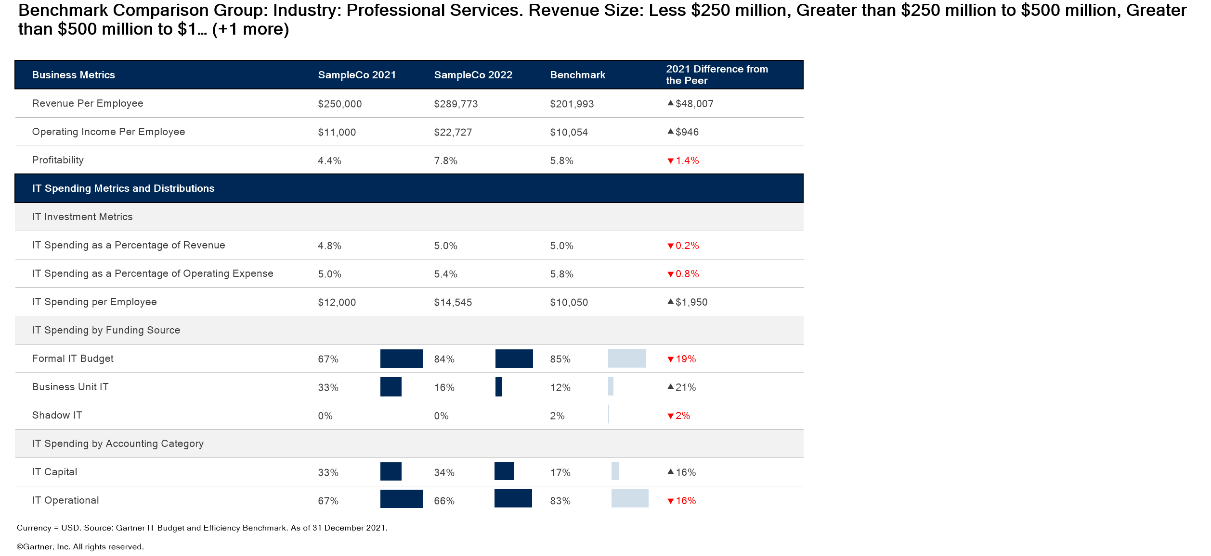
Executive Summary — IT Spend Baseline

Slide 11
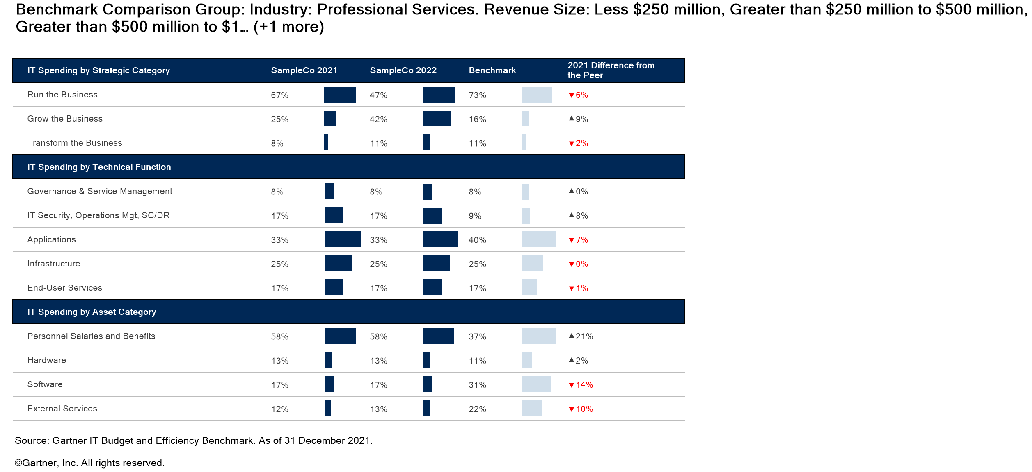
Executive Summary — IT Spend Distributions

Slide 12
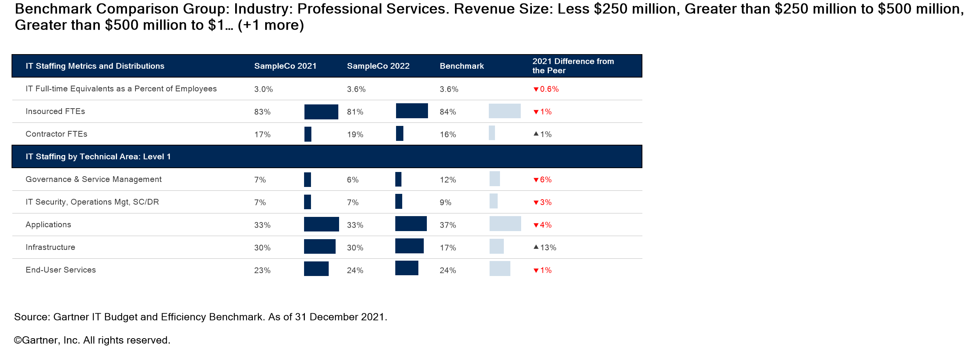
Executive Summary — IT Staffing

Slide 13
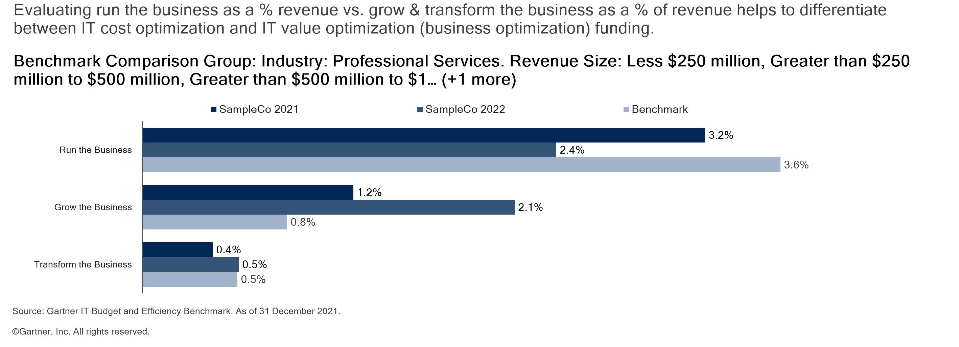
Strategic IT Spend Summary

Slide 14
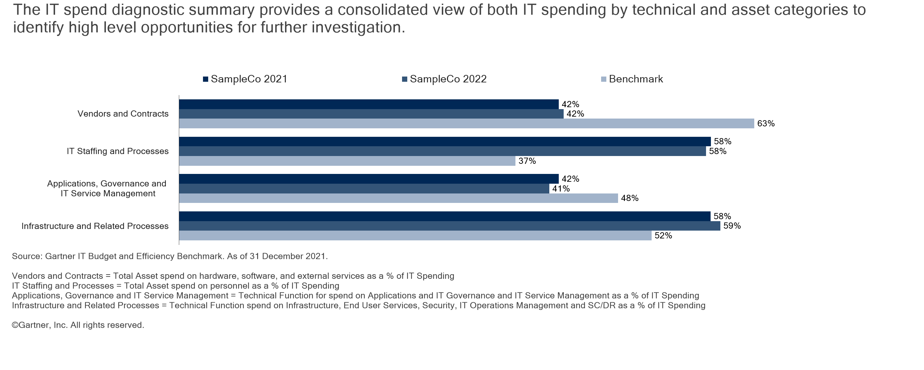
IT Spend Diagnostic Summary

Slide 15
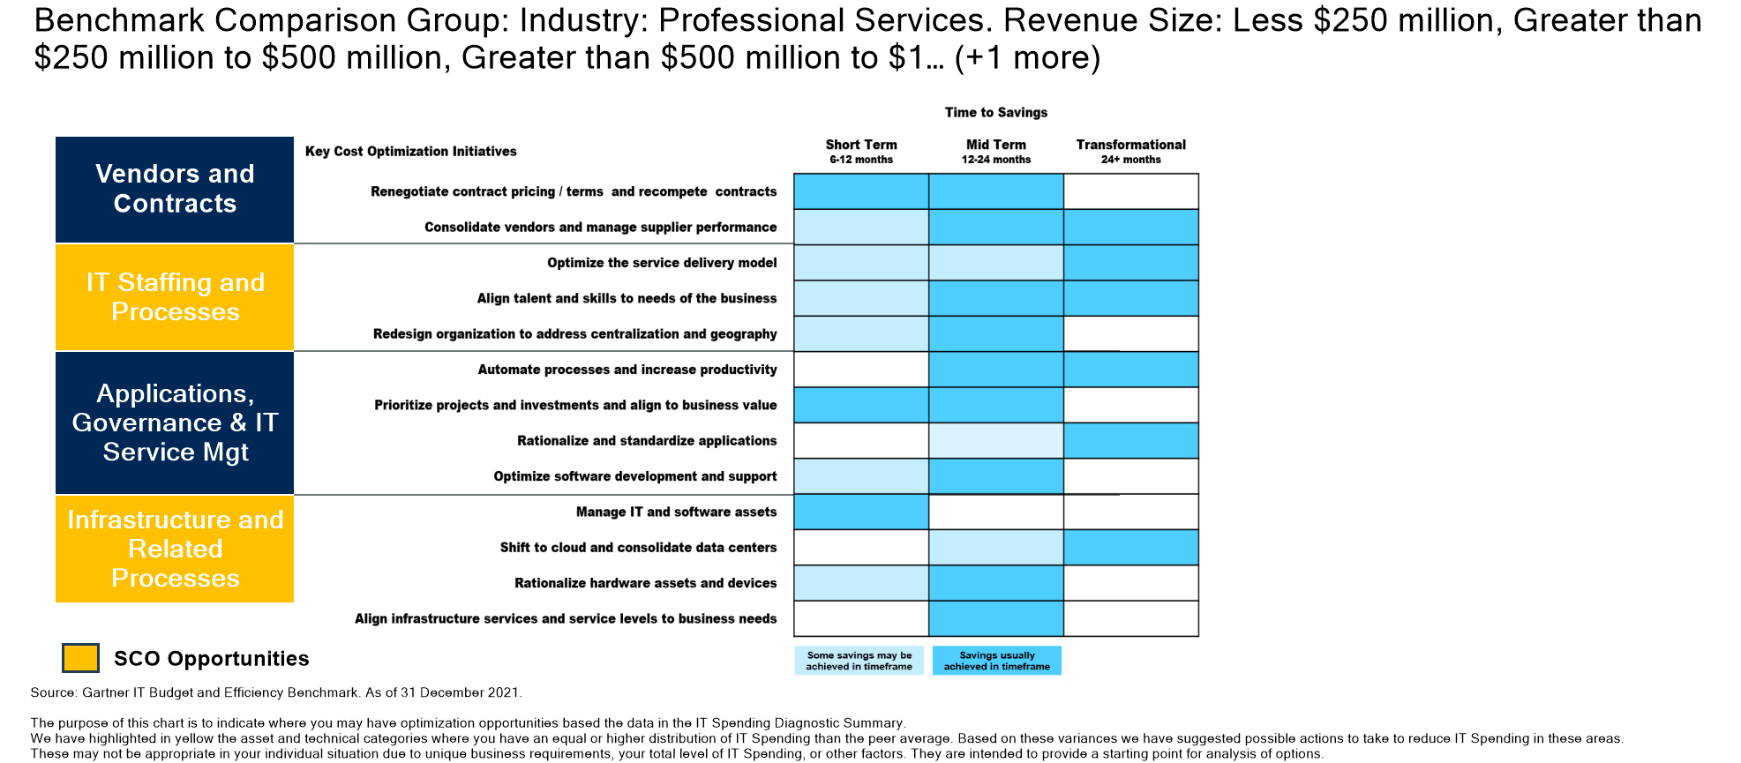
Strategic Cost Optimization Opportunities

Slide 16
Recommended Resources
Strategic Cost Optimization
Workforce Cost Management: What CIOs Need to Know and Do The CIO’s Guide to Implementing Workforce Reductions in IT Kick-Start Your IT Value Story With Metrics That Matter The 9 Rules for Demonstrating the Business Value of IT How to Identify Metrics and KPIs to Measure IT’s Business Value Contribution 12 Rules of IT Cost Management How to Respond to Mandatory IT Budget Cuts Expert Insight Video: CIOs Should Prepare Now for Financial Discussions With CFOs and the C-Suite Expert Insight Video: 5 Best-Practice Rules for Chargeback Tool: Business Value Discovery Workshop for the CIO Toolkit: How to Present Your IT Budget to the Board of Directors Toolkit: Gartner’s Ideas for IT Cost Optimization

Slide 17


Slide 18
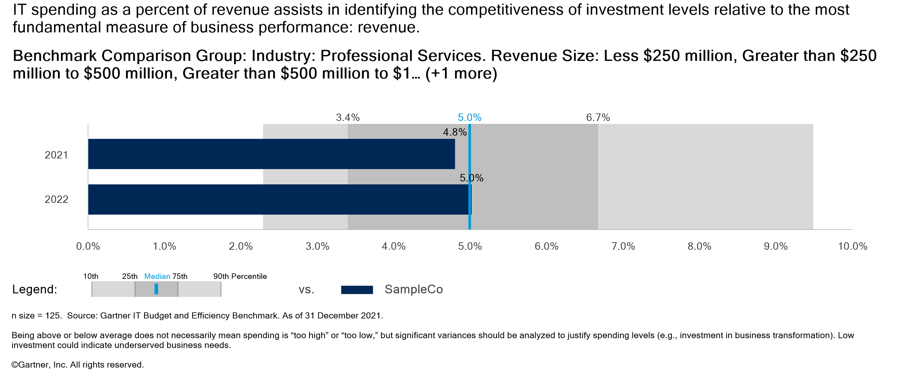
IT Spending as a Percent of Revenue

Slide 19
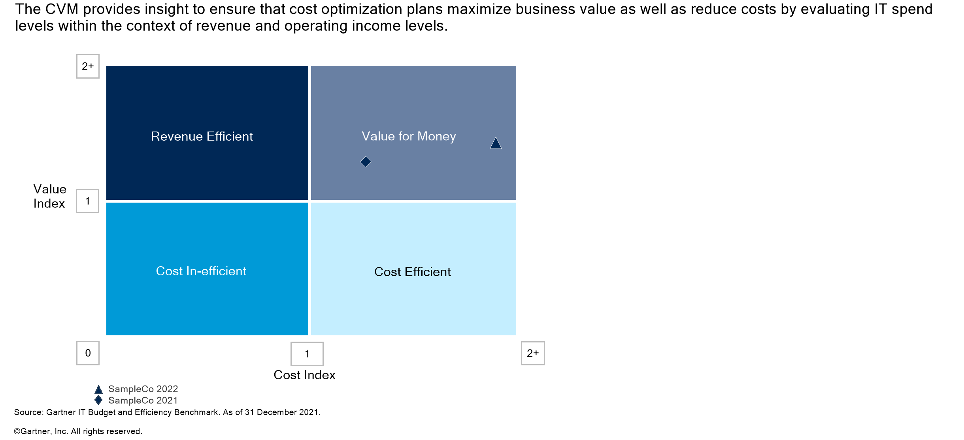
Cost Value Matrix (CVM)

Slide 20
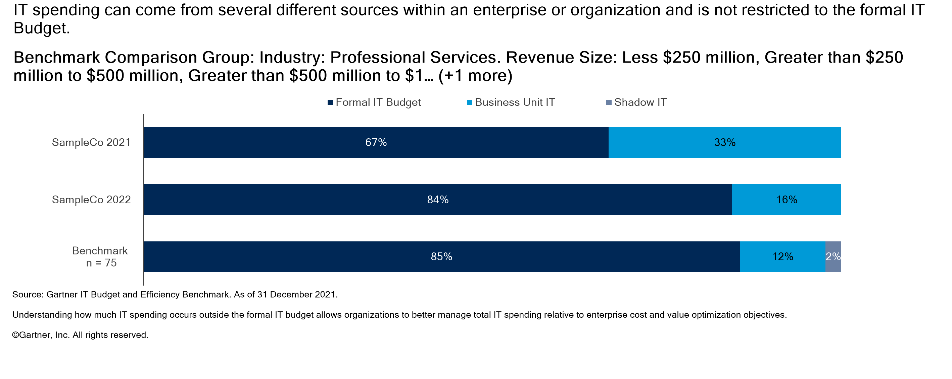
IT Spending by Funding Source

Slide 21


Slide 22
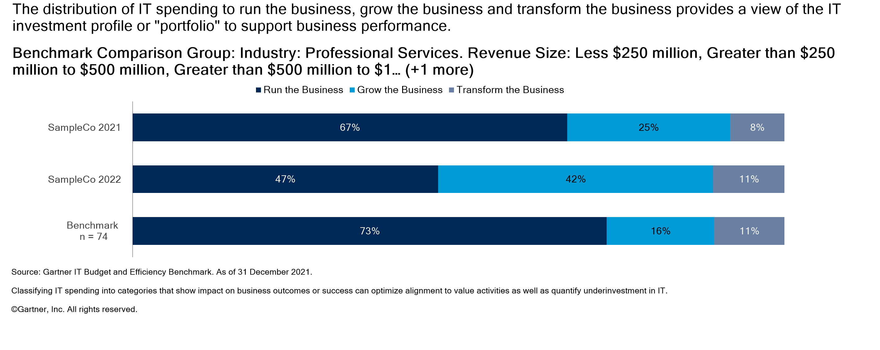
Strategic IT Spending to Change the Business

Slide 23
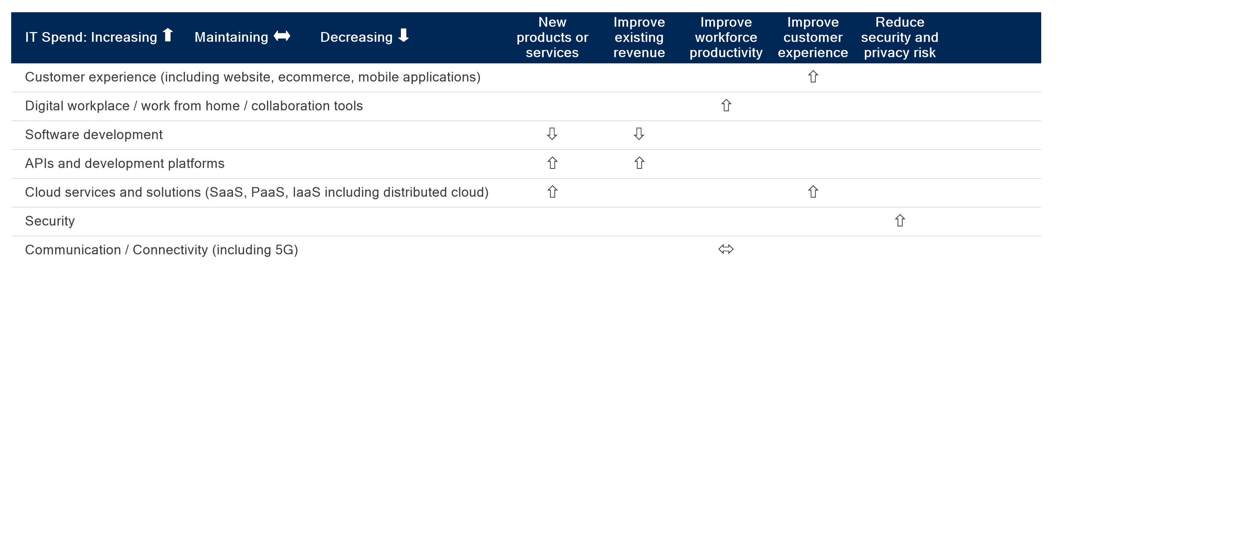
IT Investments Aligned With Value

Slide 24


Slide 25
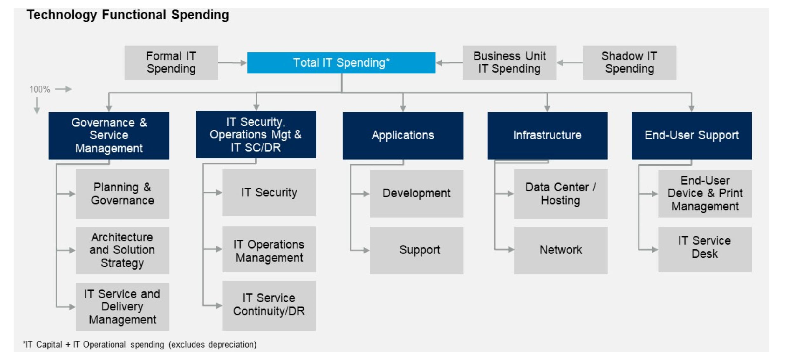
IT Supply-Side Technology Cost Management Framework

Slide 26
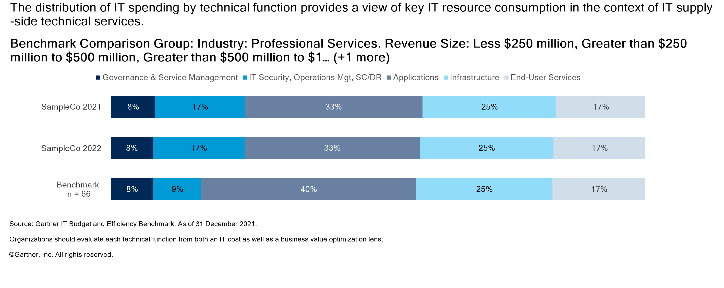
IT Spending Distribution by Technical Function

Slide 27


Slide 28
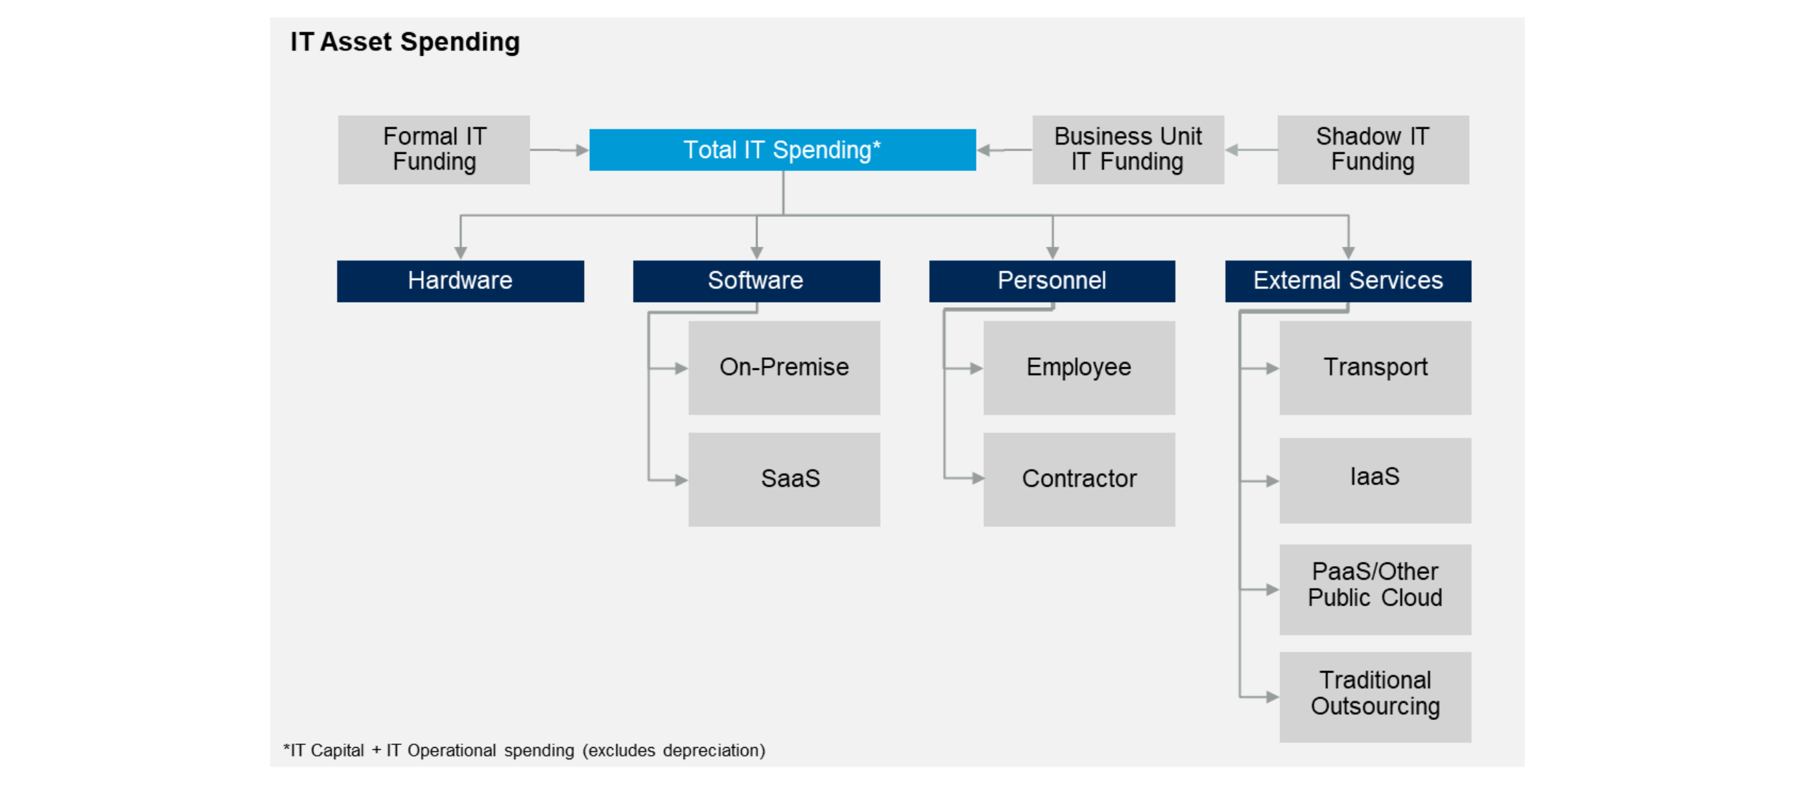
IT Supply-Side Asset Cost Management Framework

Slide 29
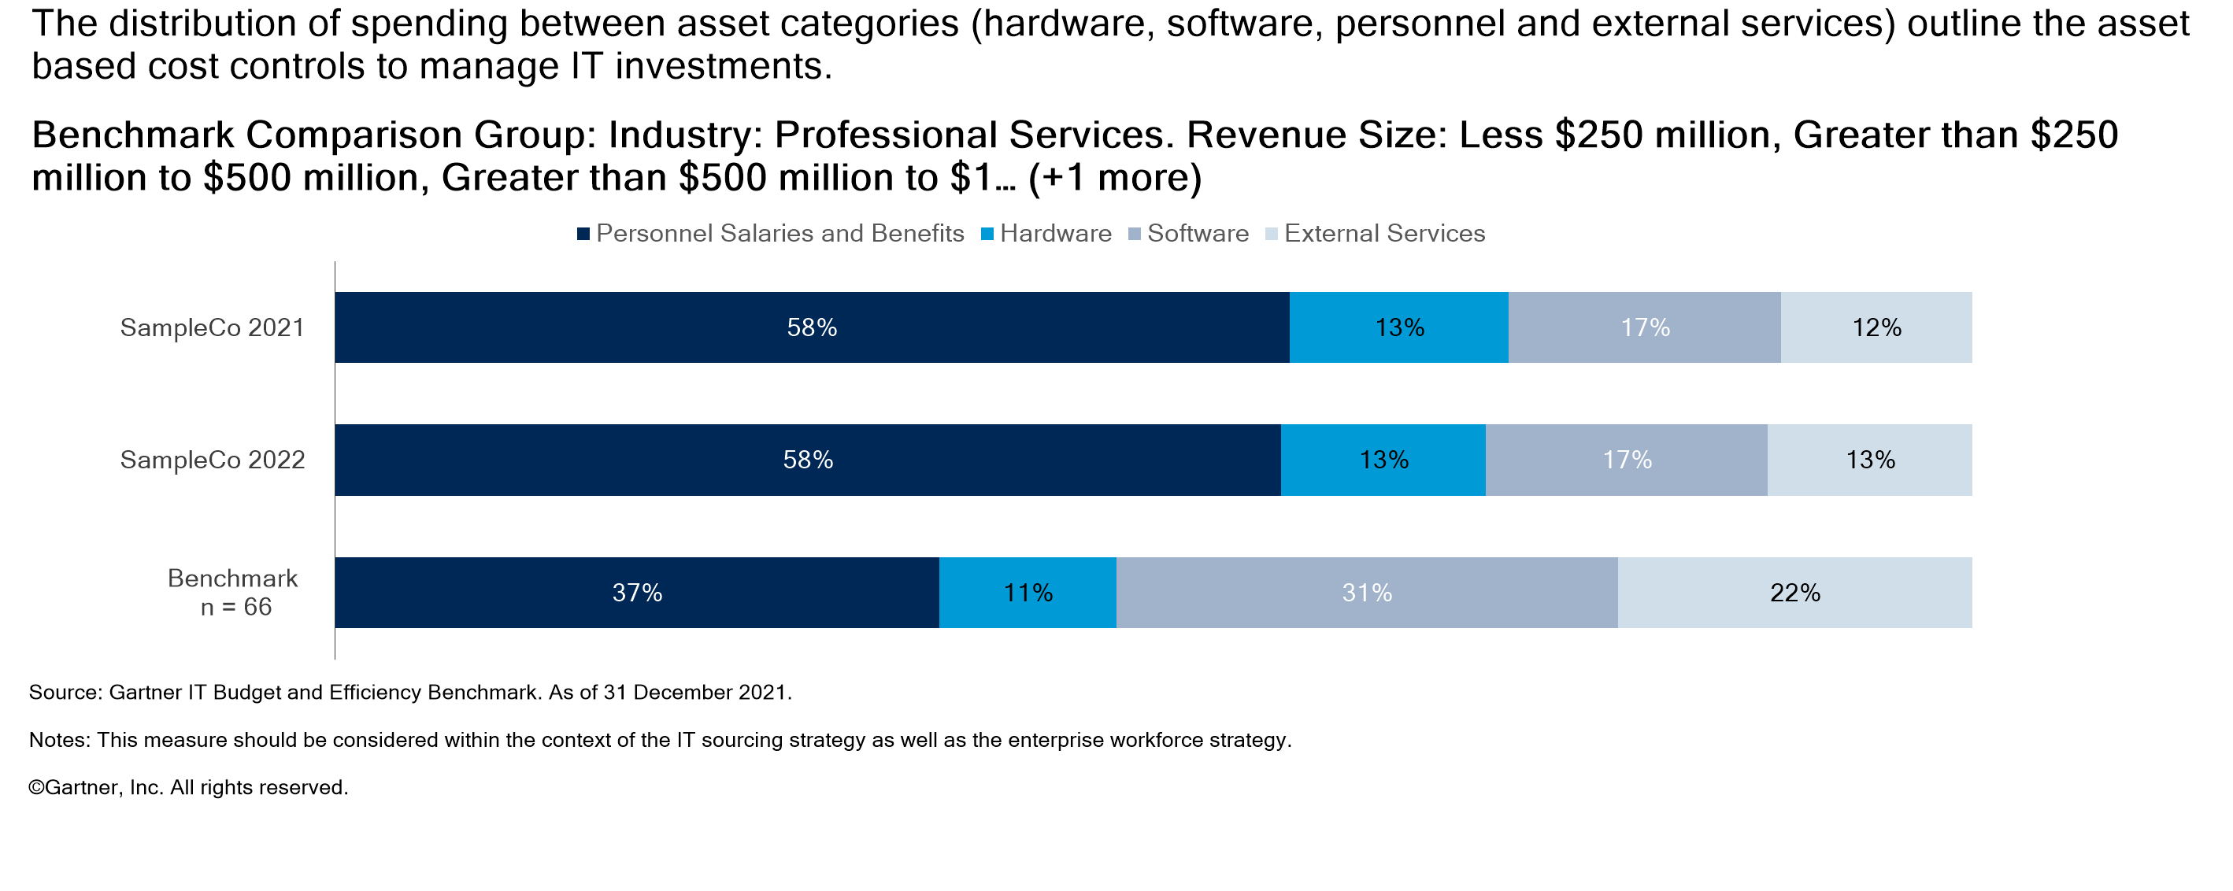
IT Spending by Asset Class

Slide 30


Slide 31
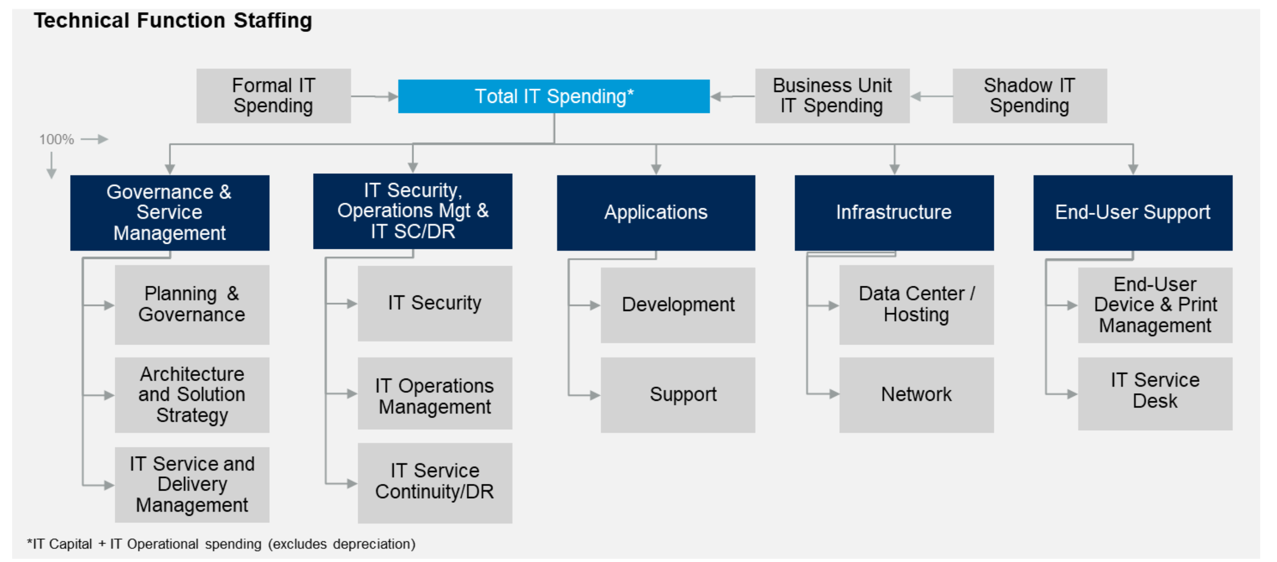
IT Supply-Side Technology Cost Management Framework

Slide 32
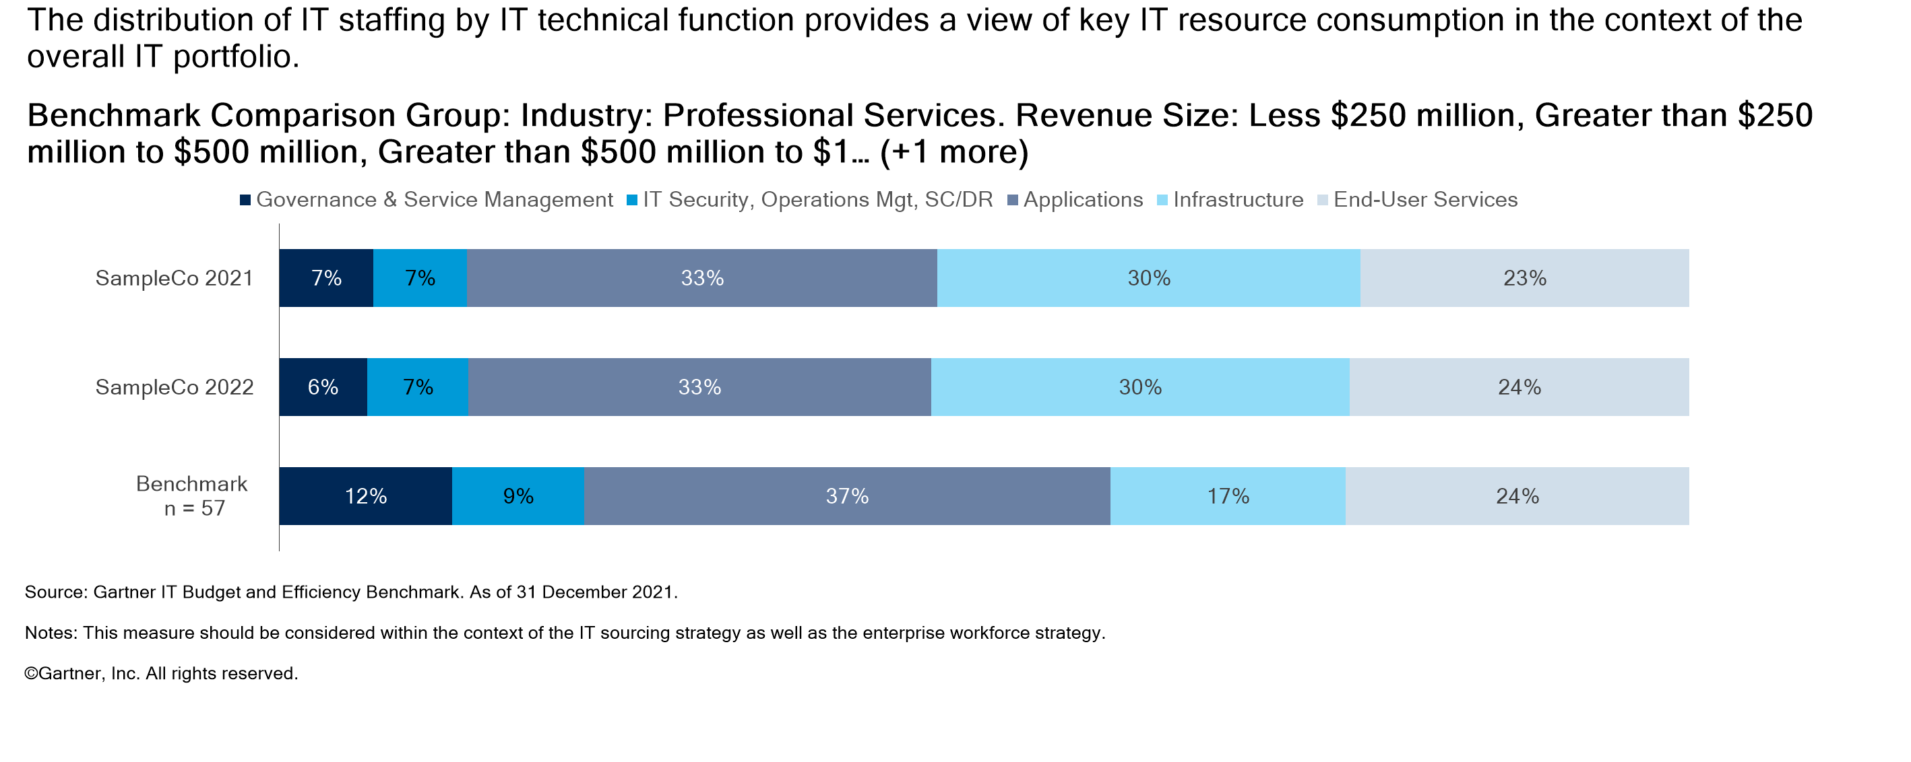
IT Staffing Distribution by Technical Function

Slide 33


Slide 34
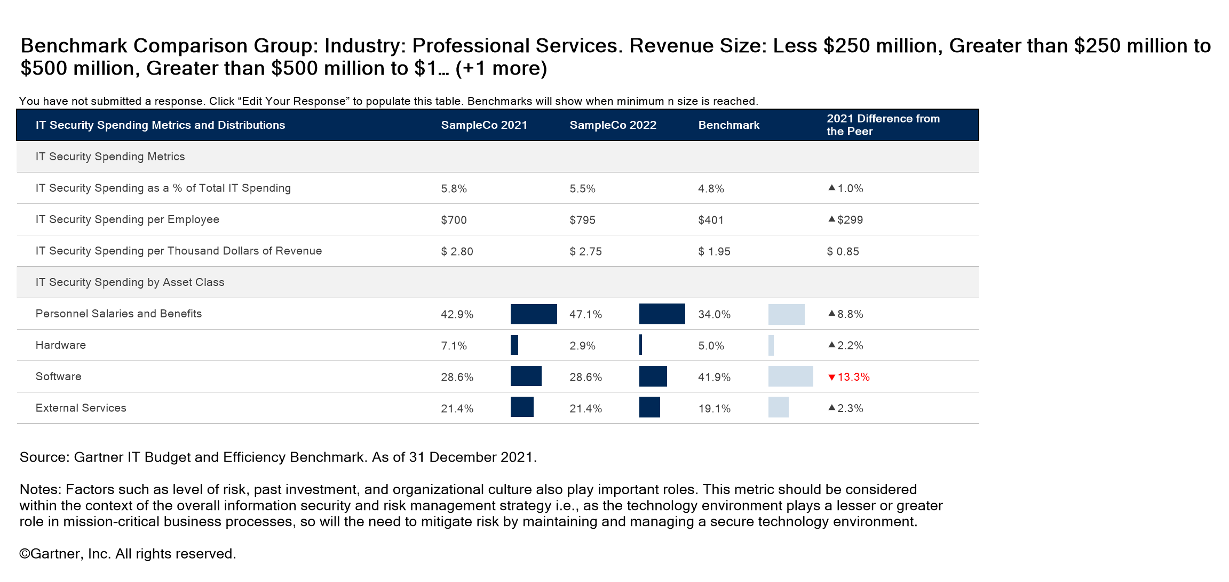
Security Analysis Summary

Slide 35
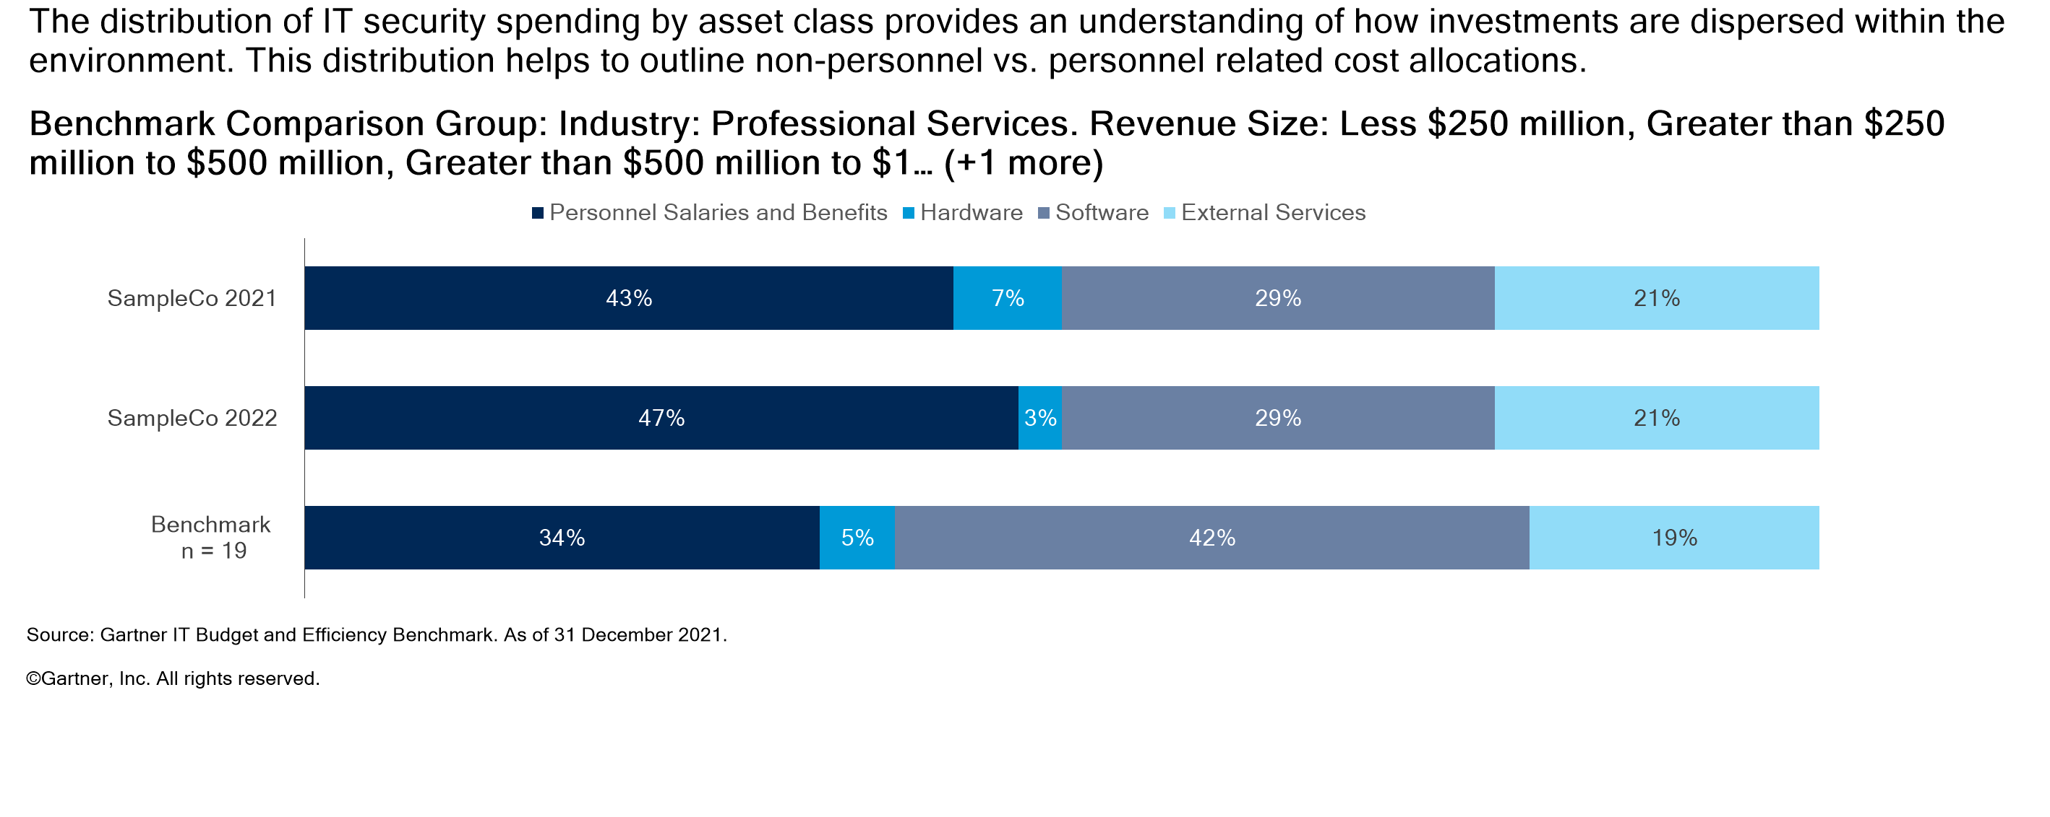
IT Security Spending by Asset Class

